Slide 1
PROVERB
English proverbs and Japanese proverbs

Slide 2
It is no use crying over spilt milk.

Slide 3
覆水盆に返らず。
It is no use crying over spilt water.

Slide 4
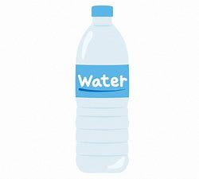
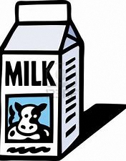
The U.S.
Japan
People usually drink milk.
Drinking milk is not very common.

Slide 5
Too many cooks spoil the broth .

Slide 6
船頭多くして船山に上る。
Too many boatmen bring the ship to the mountain.

Slide 7
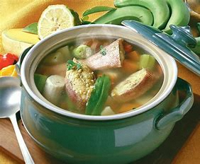
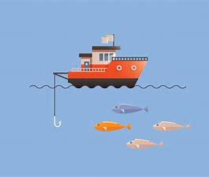
The U.S.
Japan
People eat meat a lot .
Japan is an island country, and use ships a lot.
broth
fish

Slide 8
Bread is better than the song of birds.

Slide 9
花より団子
Dumpling is better than flowers.

Slide 10
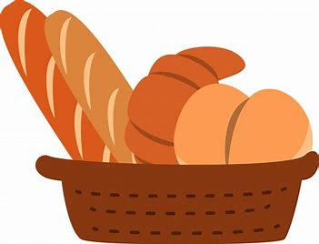
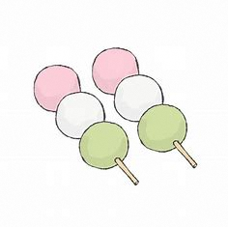
The U.S.
Japan
People usually eat bread.
People usually eat dumpling made from rice.

Slide 11
The difference of the culture of the two countries!!

Slide 12
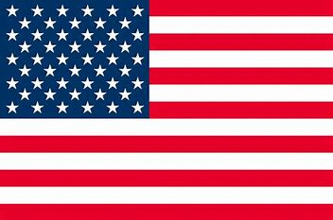
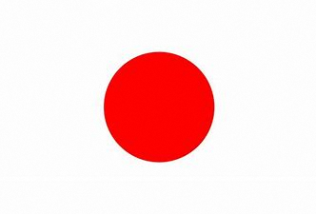
Conclusion
The culture of the country has a deep relationship with words.
Cultural differences appear as language differences.

