Slide 1
Trip & Transportation
7 Minami Araki Mizuki Taira

Slide 2
① Trip
② Transportation

Slide 3
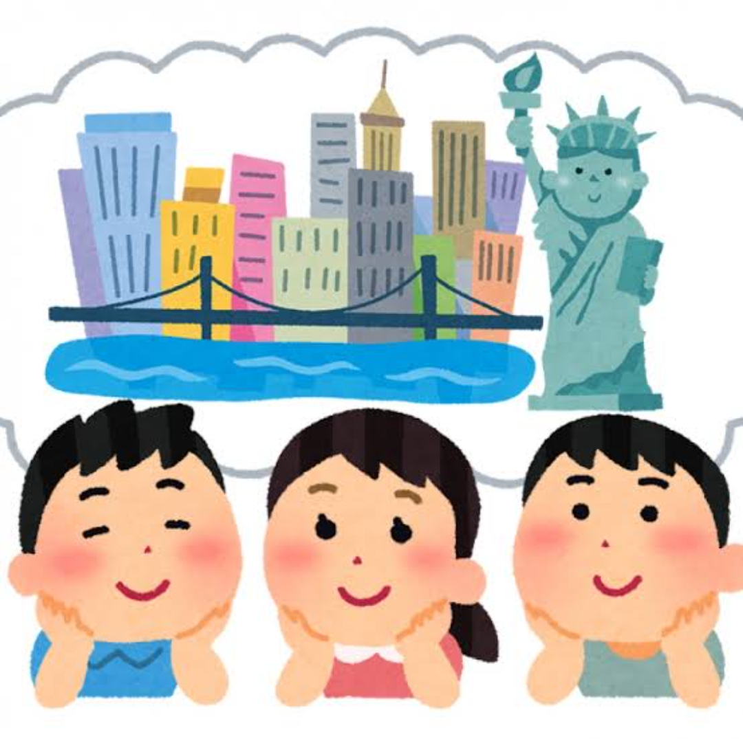

Slide 4
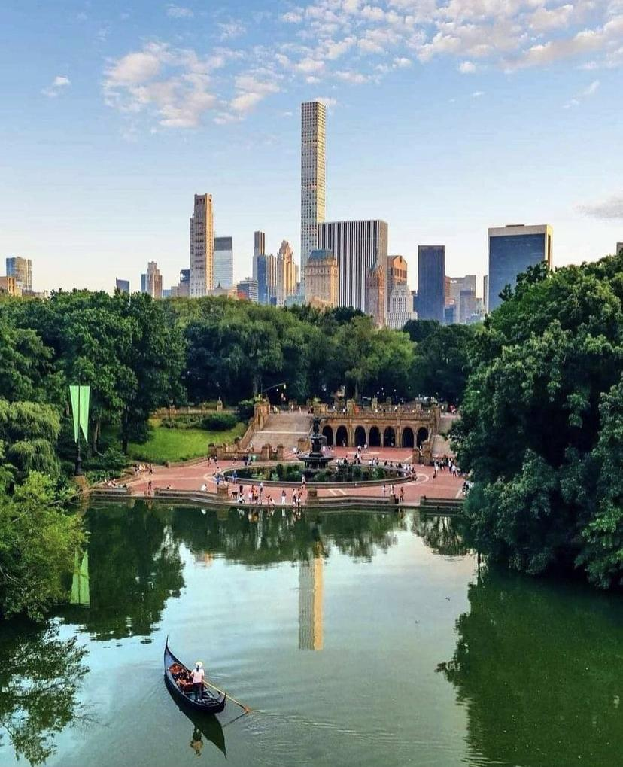
Central Park

Slide 5
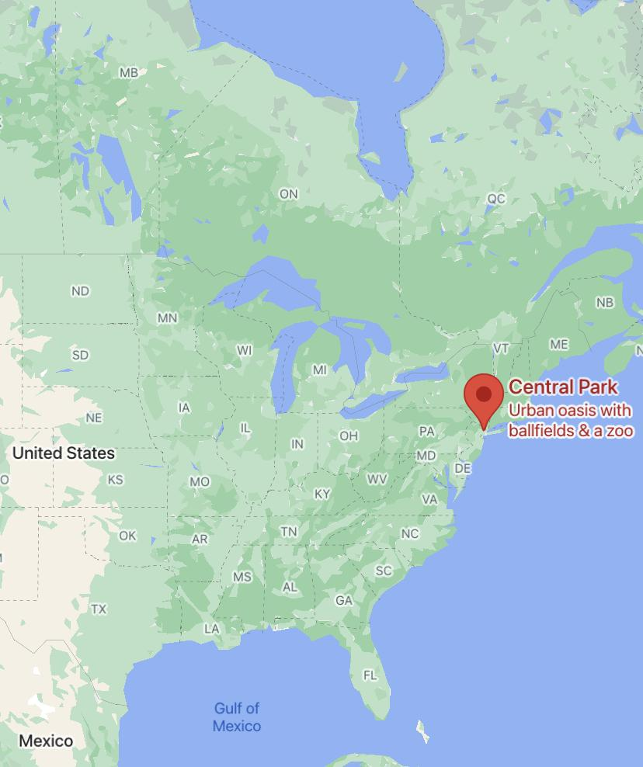
In New York

Slide 6
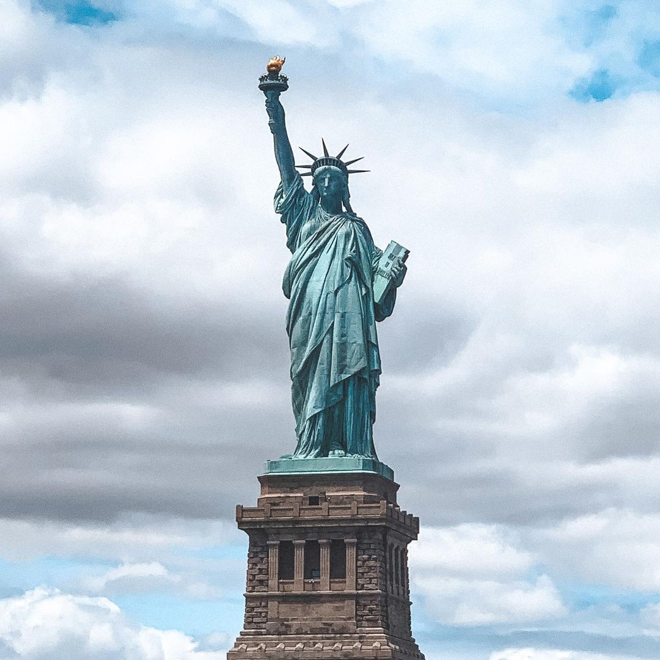
Statue of Liberty

Slide 7
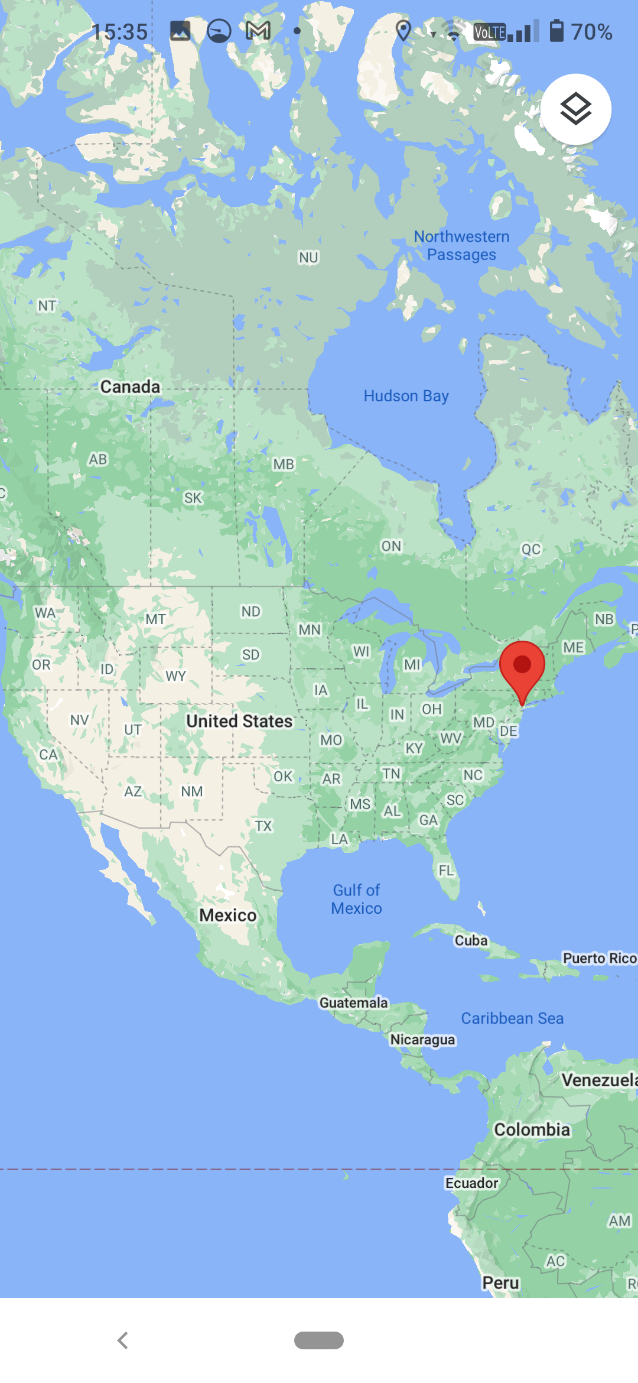
In New York

Slide 8
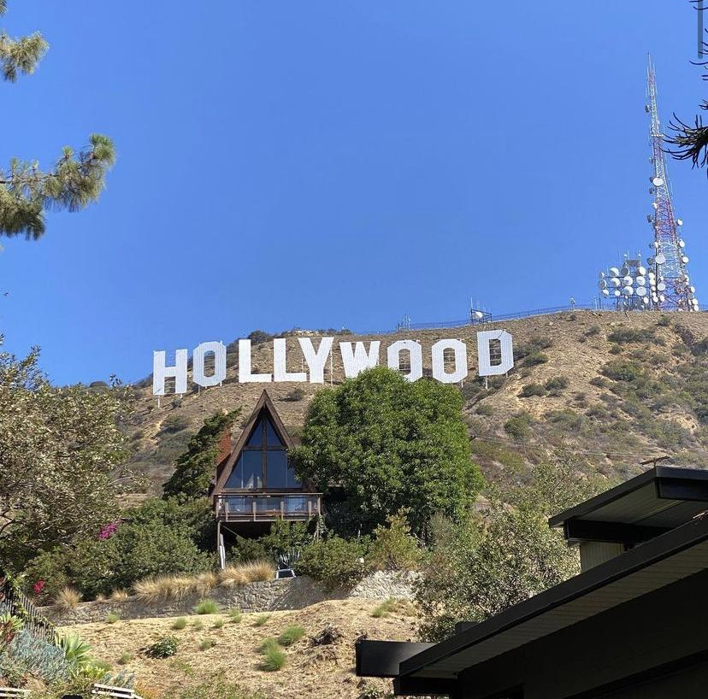
Hollywood

Slide 9
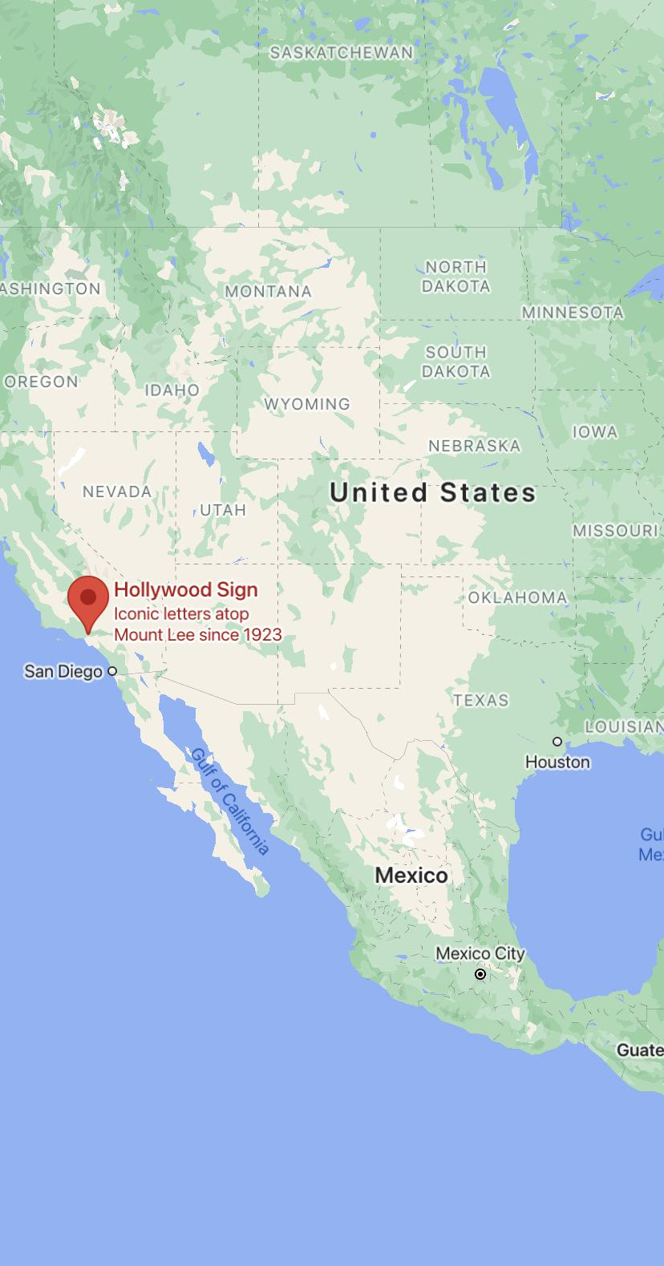
In Los Angeles

Slide 10
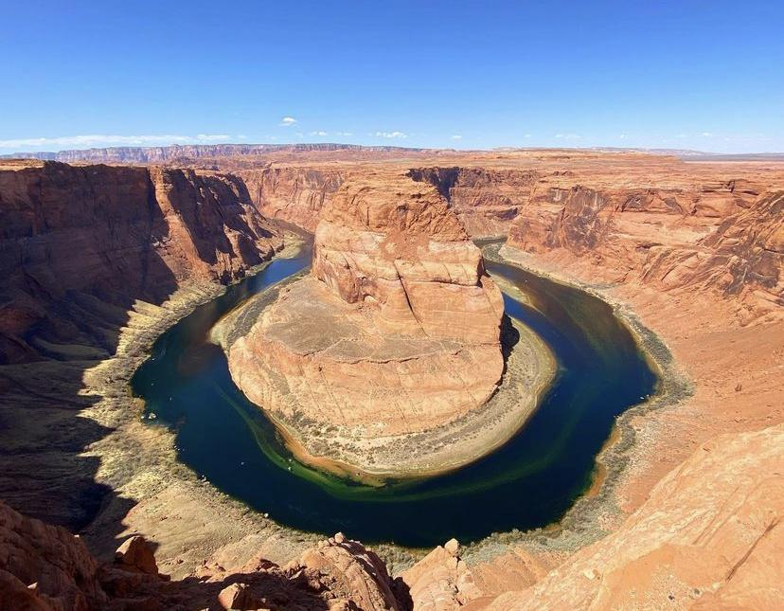
Grand Canyon

Slide 11
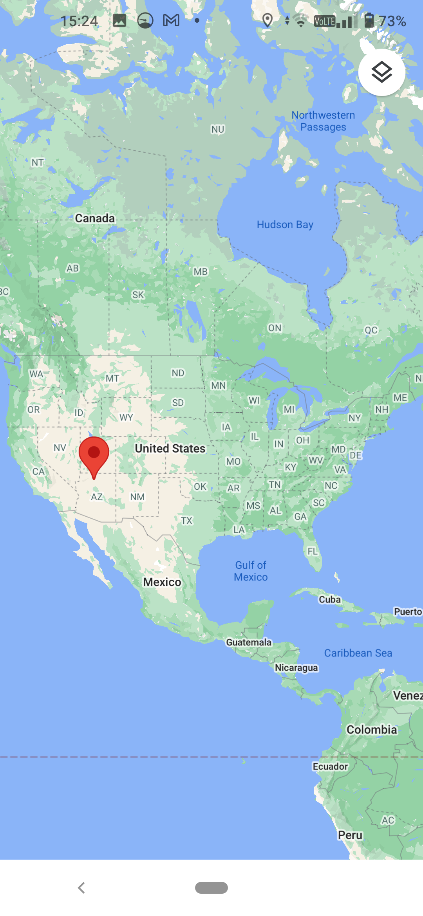
In Arizona

Slide 12
In Montana

Slide 13
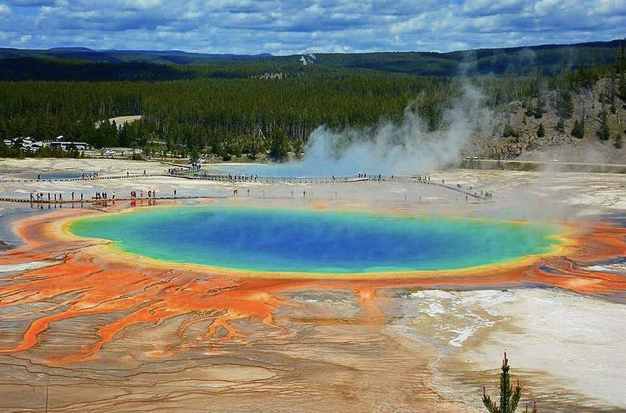
Yellowstone National Park

Slide 14
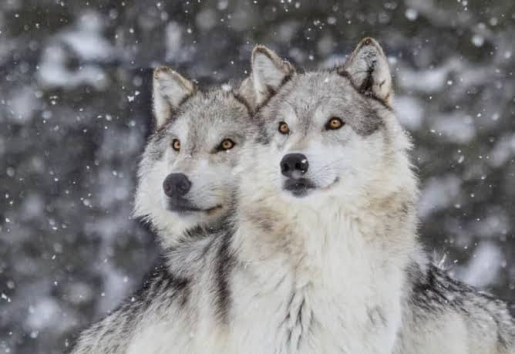
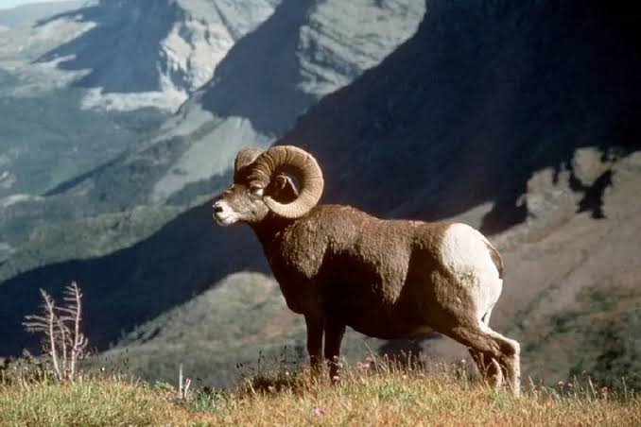
Wolf
Big Horn

Slide 15
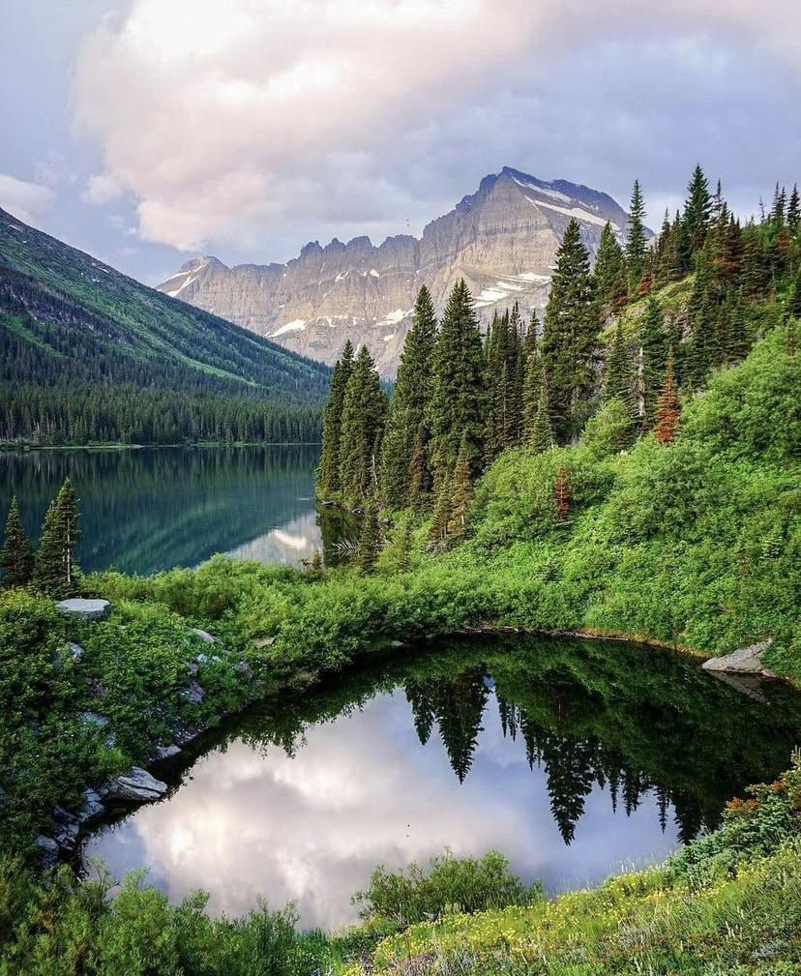
Glacier National Park

Slide 16
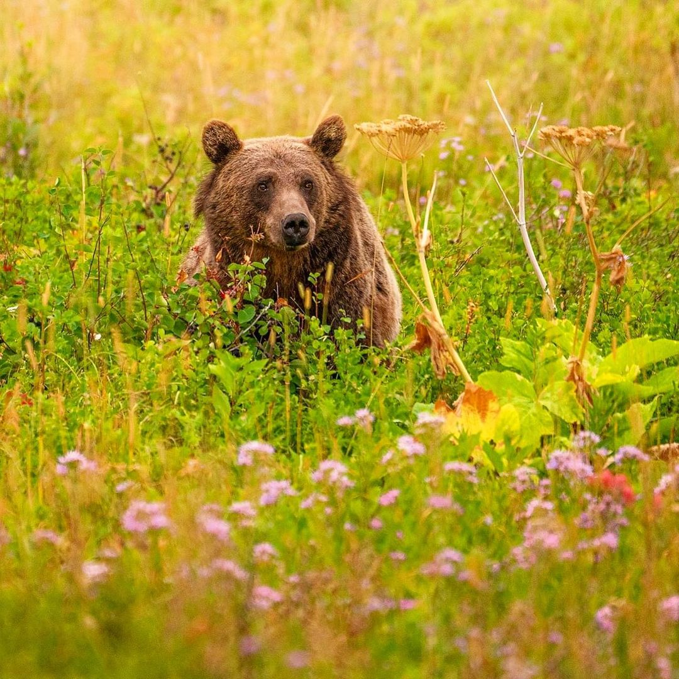
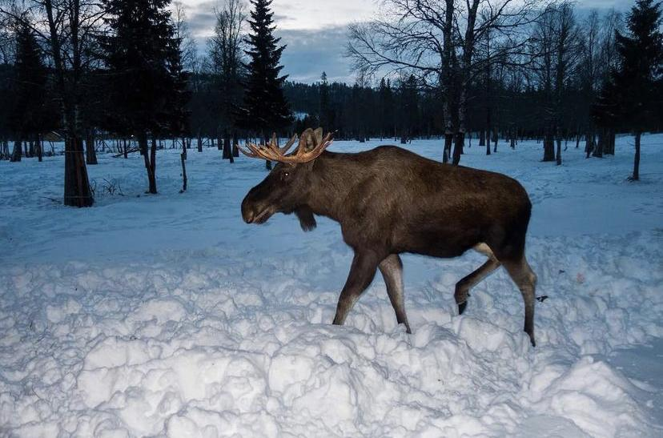
Grizzly bear
Elk

Slide 17
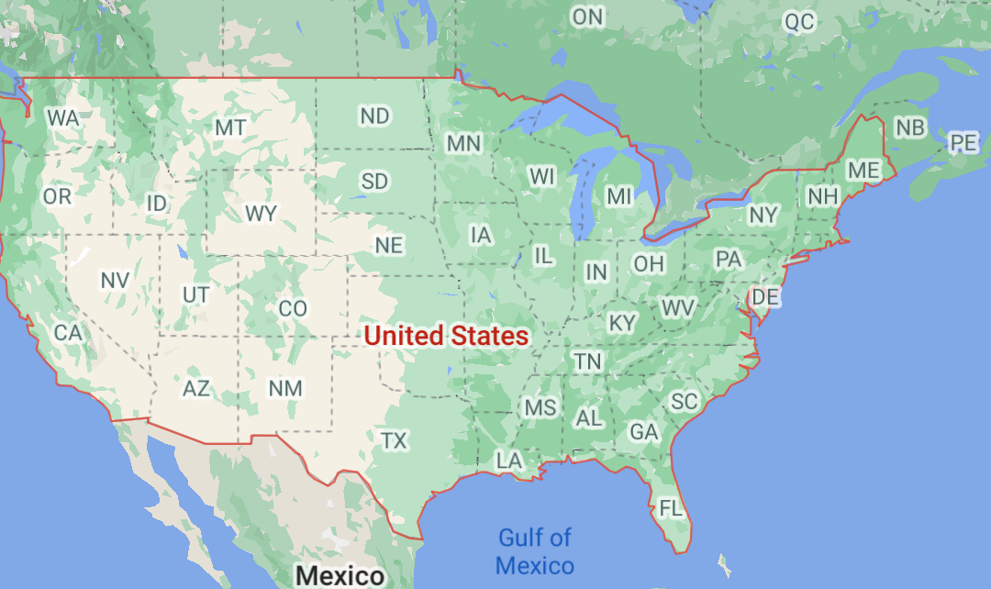

Slide 18
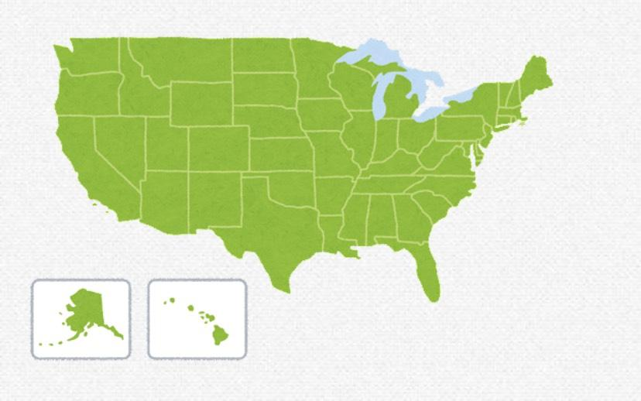
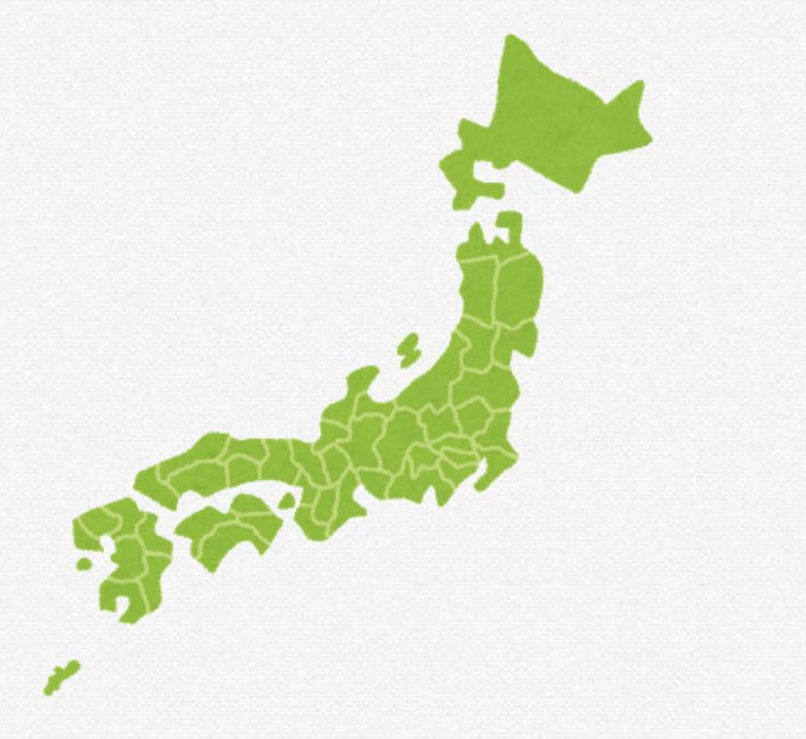
Let’s compare America🇺🇸 with Japan🇯🇵

Slide 19
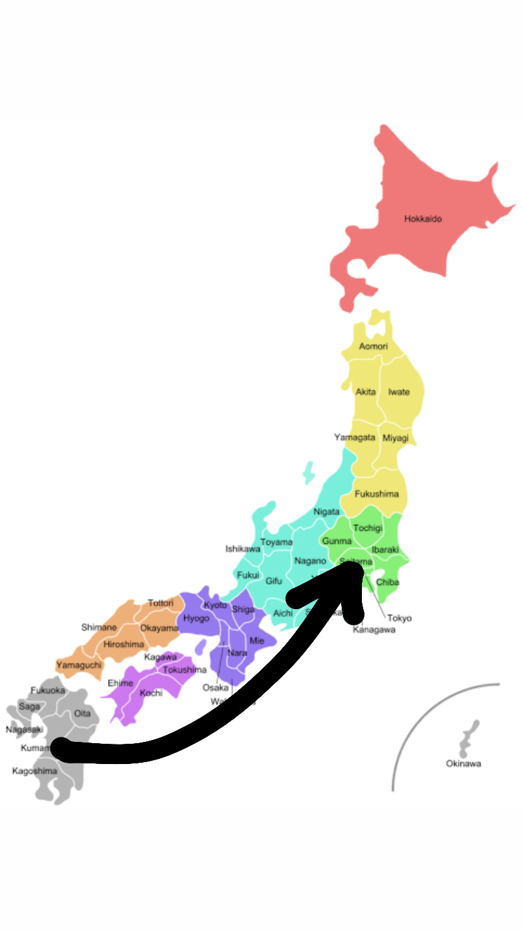

Less than one day

Slide 20
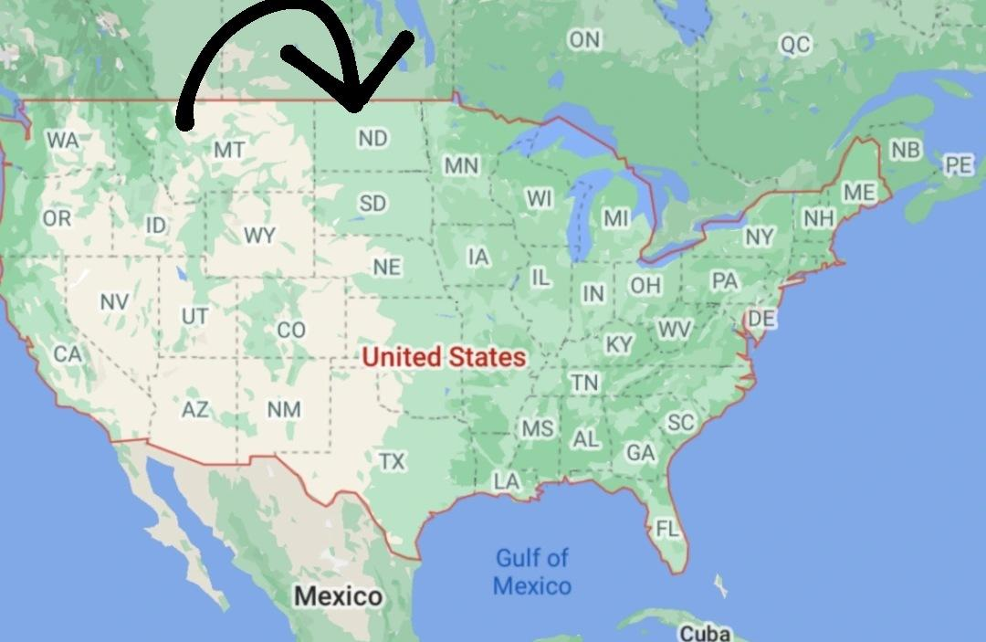
3 days

Slide 21
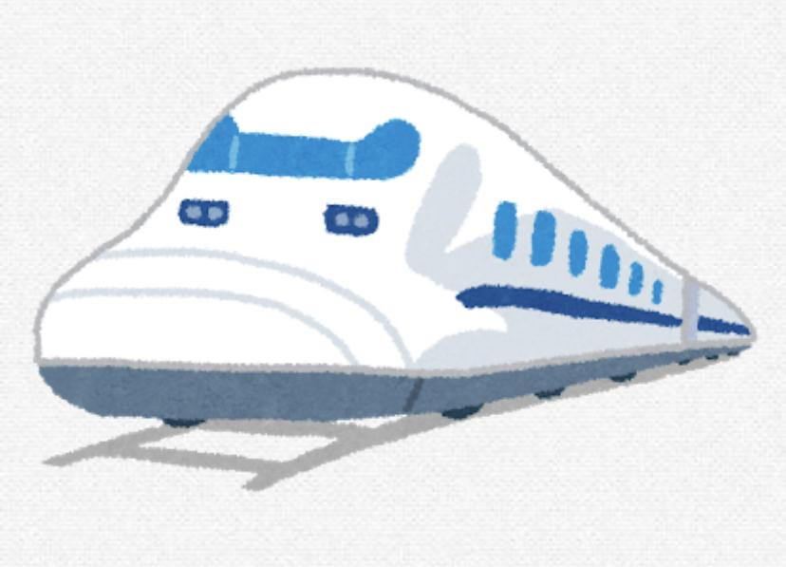
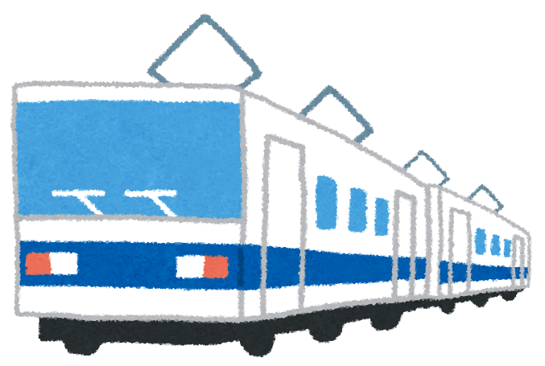
🔺

Slide 22
❌

Slide 23


Slide 24
service area

Slide 25
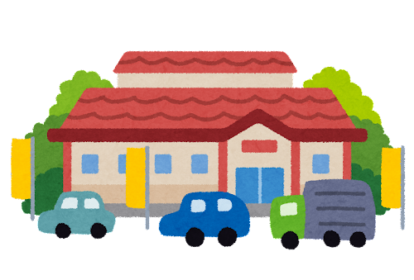

Slide 26
In America

Slide 27
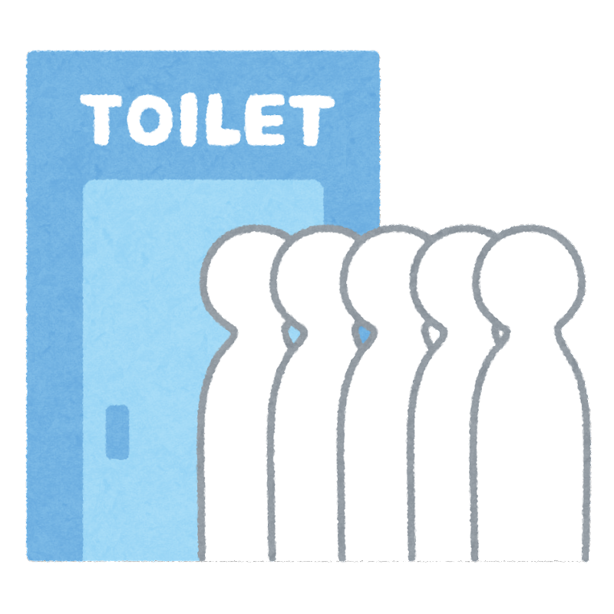

Slide 28
In Japan

Slide 29



Slide 30
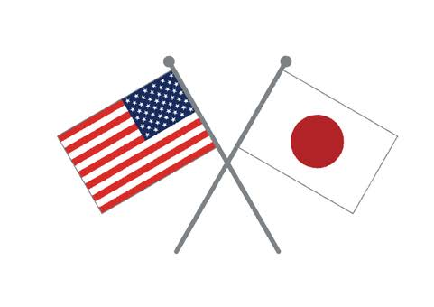

Slide 31
Thank you for listening

